Slide 1

بنام خدا
پاورپوینت درس زبان عمومی
Thoughts & Notions
متن درسها همراه با ترجمه و فایل صوتی وتمرینات درسها
رشته های تدریس : عربی ورودی 97 – زیست شناسی ورودی 97 - مشاوره الف وب ورودی 97
دهقان افراسیابی
سالتحصیلی 98 -99
نیمسال دوم

Slide 2
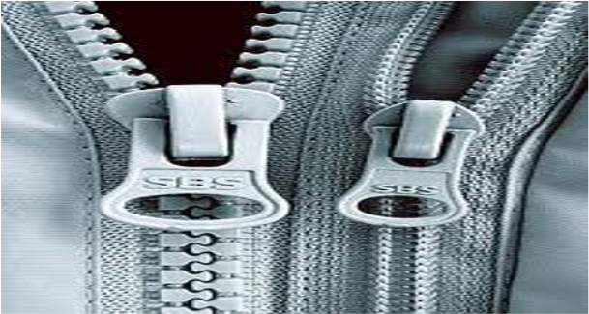
Unit 1
Inventions and Inventors
Lesson 1
The Zipper
Before You Read
1. Are you wearing something with a zipper?
2. What can you do when a zipper on a piece of clothing breaks ?
3. Do you have any clothing without zippers? How does it close?

Slide 3

Lesson 1 The Zipper
The zipper is a wonderful invention. How did people ever live without zippers? They are very common, so we forgot that they are wonderful. They are very strong, but they open and close very easily. They come in many colors and sizes.
In the 1890s, people in the United States wore high shoes with long row of buttons. Clothes often had rows of buttons too. People wished that clothes were easier to put on and take off.
Whitcomb L. Judson, an engineer from the United states, invented the zipper in 1893. However, his zippers didn’t stay closed very well. This was embarrassing, and people didn’t buy many of them. Then Dr. Gideon Sundback from Sweden solved this problem. His zipper stayed closed.
A zipper has three parts: 1. there are dozens of metal or plastic hooks (called teeth) on two rows. 2.These are fastened to two strips of cloth. The cloth strips are flexible. They bend easily. 3. A fastener slides along and joins the hooks together. When it slides the other way, it takes the hooks apart.
Dr. Sundback put the hooks on the strips of cloth. The cloth holds all the hooks in place. They don’t come apart very easily. This solved the problem of the first zippers.

Slide 4
ترجمه درس 1 زیپ
زیپ اختراع شگفت انگیزی است .چگونه مردم تا کنون بدون زیپ زندگی میکردند؟ آنها (زیپ ها) خیلی معمولی هستند .بنابراین فراموشی می کنیم که آنها شگفت انگیزند .آنها بسیار محکم هستند، اما به آسانی بازو بسته میشوند .آنها در رنگها و شکلهای بسیاری وجود دارند.
در دهه 1980، مردم ایالات متحده کفشهای بلندی با ردیف بلندی از دکمه ها می پوشیدند. لباسها نیز اغلب ردیفهایی از دکمه را داشتند .مردم آرزو داشتند پوشیدن و درآوردن لباسها آسانتر می بود.
ویتکامب ال جادسون ، مهندسی از ایالات متحده، در سال ۱۸۹۳ زیپ را اختراع کرداما زیپهای او خیلی خوب جفت نمی شدند.
این نوع زیپ ها خجالت آور بود و مردم خیلی از آنها نخریدند .سپس دکترگیدن ساندیکا سوئدی این مشکل را حل کرد.
زیپ دارای سه بخش است.1 . دوجینهایی از قلابهای فلزی یا پلاستیکی (که دندانه نامیده میشوند )در دو ردیف وجود دارد. 2. این قلابها به دولبه لباس بسته می شوند .لبه های لباس انعطاف پذیر هستند آنها به آسانی خم می شوند. 3. یک بست یا گیره در امتداد قلابها بالا و پایین میرود و آنها را به هم وصل می نماید. وقتی به سمت دیگری حرکت می کند، قلابها را از هم جدا میکند.
دکتر ساندبک این قلابها را روی نوارهایی از پارچه گذاشت .پارچه تمامی این قلابها را در جای خود نگه میدارد .آنها به آسانی از هم جدا نمی شوند .این کار مشکل زیپ های اولیه را حل کرد.

Slide 5
A. Vocabulary
Put the right word in each blanks. The sentences are from the text.
zipper embarrassing hooks dozens solved, bend, fastened, apart, strips, row, engineer, slides
1. In the 1890s, people in the United States wore high shoes with long... row.....of buttons.
2. There are.... dozens ......of metal or plastic..... hooks..... (called teeth) in two rows.
3. The.... zipper ....is a wonderful invention.
4. A fastener...... Slides.... along and joins the hooks together.
5. Whitcomb L. Judson, an ... engineer....from the United States, invented the zipper in 1893.
6. When it slides the other way, it takes the hooks ..... apart.... .
7. This was ...... embarrassing....... and people didn’t buy many of them.
8. They ...... bend.... easily.
9. These hooks are......... fastened.........to two .......strips..........of cloth.
10. Then Dr. Gideon Sundback from Sweden......... solved............ this problem.

Slide 6
B. Vocabulary (new context)
Put the right word in the blanks.
embarrassed, engineer, strips, zippers, hook, rows, fasteners, bend, apart, dozen, slide, solve
1. Icy roads are dangerous because cars... slide...on them.
2. Pam cut a piece of paper into five ....... strips......... .
3. Sometimes your face gets red when you feel.... embarrassed...
4. Do you like to .... solve.....math problems?
5. You can catch fish with a.... hook....... .
6. Hooks, buttons, and zippers are all ........ fasteners........... .
7. American supermarkets sell eggs by the ...... dozen........ .
8. Tony and George had an apartment together, but now they live .... apart.......... .
9. Students sit in a circle in some classes. They sit in .... rows....in others.

Slide 7
10. You .......bend.......... Your knees when you sit down.
11. Most pants and jackets have .......zippers........... .
12. An .......engineer....... Knows how to build a road.
C. Comprehension
Put a circle around the letter of the best answer.
1. Zippers open and close by .............. .
a. shooting b. sliding c. bending d. choosing
2. The hooks on a zipper are ................... .
a. plastic b. metal c. cloth d. a and b
3. Mr. Judson was an .................. .
a. engineer b . inventor c. American d. a and b
4. Mr. Judson didn’t sell many zippers because.....................
a. It was hard to open and close b. People liked rows of buttons
c. They had cloth strips d. They came open very easily

Slide 8
5. Dr. Sundback was ................ .
a. a Swede b. from Chicago c. an American d. band c
6.A zipper has two.................. of cloth.
a. rows b. fasteners c. strips d. buttons
7. ................are flexible.
a. The hooks b. The rows of buttons c. The fasteners d. The strips of cloth
8. Dr. Sundback ______________.
a. invented the zipper b. made the zipper better
c. invented the button hook d. invented the slide fastener
The end of lesson 1

Slide 9
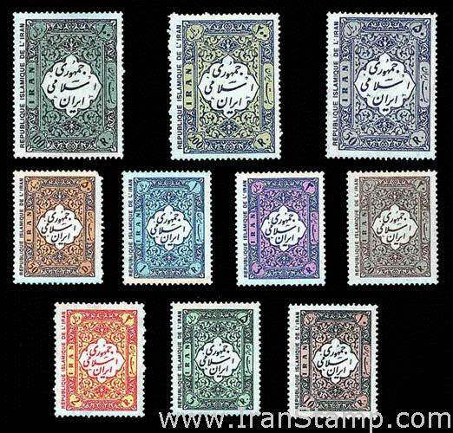
Lesson 2 The Postage Stamp
Before You Read
1. Does someone in the class have a postage stamp? What does it look like?
2. How much does it cost to mail a letter today ?
3. Name a famous person on a postage stamp.

Slide 10
Lesson2 The postage stamp
Before the invention of the postage stamp, it was difficult to send a letter to another country. The sender paid for the letter to travel in his or her own country. Then the person in the other country paid for the rest of the trip. If a letter crossed several countries, the problem was worse.
Rowland Hill, a British teacher, had the idea of a postage stamp with glue on the back. The British post office made the first stamps in 1840. They were the penny black and the Twopence Blue. A person bought a stamp and put in on a letter. The post office delivered the letter. When people received letters, they didn’t have to pay anything. The postage was prepaid.
Postage stamps became popular in Great Britain immediately. Other countries started making their own postage stamps very quickly.
There were still problems with international mail. Some countries did not want to accept letters with stamps from other countries. Finally, in 1874, a German organized the Universal Postal Union (UPU). Each country in the UPU agreed to accept letters with prepaid postage from the other members. Today, the offices of the UPU are in Switzerland. Almost every country in the world is a member of this organization. It takes care of any international mail problems.
Today, post offices in every country sell beautiful stamps. Collecting stamps is one of the most popular hobbies in the world, and every stamp collector knows about the Penny Black and the Twopence Blue.

Slide 11
ترجمه درس 2 تمبر
قبل از اختراع تمبر پست، ارسال یک نامه به کشوری دیگر دشوار بود. فرستنده برای حمل نامه در کشورخودش هزینه پرداخت میکرد. پس از آن فرد در کشوری دیگر هزینه ای برای بقیه سفر پرداخت می کرد. اگر یک نامه از چند کشور می گذشت، مشکل بدتر می شد.
رولند هیل، یک معلم بریتانیایی، ایده ی یک تمبر پستی با چسب در پشت را داد. اداره پست بریتانیا اولین تمبر را در سال 1840 ساخت. آنها سیاه پنی و آبی دومپنی بودند . یک فرد تمبر می خرید و آن را روی نامه قرار می داد. اداره پست نامه را تحویل می گرفت. زمانی که مردم نامه ها را دریافت می کردند، آنها مجبور نبودندچیزی پرداخت کنند .نامه ها پیش پرداخت شده بودند.
تمبر پستی در بریتانیای کبیر بلافاصله محبوب شد. دیگر کشورها ساخت تمبر پستی خود را به سرعت آغاز کردند.
همچنان مشکلاتی در مورد نامه های بین المللی وجود داشت. برخی کشورها نمیخواستند نامه ای با تمبر دیگرکشور ها را قبول کنند.سرانجام ، در سال 1874، یک آلمانی اتحادیه سیستم پست جهانی را سازماندهی کرکشور عضو اتحادیه موافق بودند نامه هایی پستی پیش پرداخت شده از اعضای دیگر را بپذیرند. امروزه، دفاتر اتحادیه پستی جهانی در سوئیس هستند. تقریبا هر کشوری در جهان، عضو این سازمان است. مراقبت کردن از هر گونه مشکلات نامه بین الملی طول می کشد.
امروزه، ادارات پست در هر کشوری تمبرهای زیبا می فروشند. جمع آوری تمبر، یکی از سرگرمی های مردم پسند در جهان است و هر جمع آورکننده تمبر در مورد تمبرهای سیاه پنی و آبی دوپنی می داند.

Slide 12
a. Vocabulary
Put the right word in the blanks. The sentences are from the text.
crossed, received, postage, prepaid, members, mail, stamp, delivered, immediately, accept, glue
1. When people ...... received....... letters they didn’t have to pay anything.
2. Before the invention of the.... postage.. ..... stamp.., it was difficult to send a letter to another country.
3. The post office ..... delivered...the letter.
4. Each country in the UPU agreed to accept letters with prepaid postage from the other .... members....
5. If a letter .... crossed.....several countries, the problem was worse.
6. Postage stamps became popular in Great Britain ...... immediately.... .
7. Some countries did not want to ...... accept.... letters with stamps from other countries.
8. The postages was ..... prepaid...... .
9. There were still problems with international ...... mail.... .
10. Rowland Hill, a British teacher, had the idea of a postage stamp with .... glue.. on the back.

Slide 13
b. Vocabulary: new context
Put the right word in the blanks.
prepay, cross, postage, members, deliver, mail, immediately, accept, stamps, glue, receive
1. Jamal and Marie are ..... members.... of the International Students Club.
2. When you rent an apartment for year, you have to .... prepay.......... the last month’s rent.
3. Children have to be careful when they...... cross...... the street.
4. Mr. Ross is going to the post office because he has to buy some ..... stamps...... .
5. If you buy furniture, the store will .... deliver...... It to your house.
6. How much is the ....... postage...... for an airmail letter to Japan?
7. Did you ..... receive..... any letters this week?
8. Please go to your office ..... immediately...... . You have a long- distance phone call.
9.The teacher will not ..... accept......homework if it is late. You must do it on time.
10.Did you get any ... mail.....today?
11. ...glue... helps a stamp stay on a letter.

Slide 14
C. Comprehension: True/False/No Information
Write T if the sentence is true. Write F if it is false. Write NI if there is no information about the sentences was given in the text.
....T.....1. Before postage stamps, two people paid for letters that went from one country to another.
....T.....2. A teacher invented the postage stamp.
....F.....3. The inventor of the postage stamp was American.
....T.....4. The first two stamps were colored black and blue.
....T.....5. A stamp shows that the postage is prepaid.
....Ni....6. The United States was the second country to make postage stamps.
....F.....7. Postage stamps solved all mail problems immediately.
....T.....8. Members of the UPS accept stamps from other countries.
....NI....9. Kuwait is a member of the UPS.
....T....10. All the UPS officials are Swiss.
....T....11. Stamp collecting is a popular hobby.
The end of lesson 2

